Slide 1


Slide 2


Memory Game
Second Year Project Synopsis
Submitted by
ROLL | NAME
2301010178 | Yuvraj Singh
Industry Mentor: Mr. Sandeep Singh
Faculty Mentor: Dr. Yogita Yashveer Raghav
Notes:
New Courses replaced with New Programmes

Slide 3

Project Overview
I’m working on a Memory Game Web App. The idea is to build a fun game, where players have to match pairs of cards, testing their memory and concentration. The game will feature randomized cards, multiple difficulty levels, scoring system to make it more engaging and interesting.
I also plan to add some cool features like, multiplayer mode, time challenges to keep things exciting. The goal is to make game both entertaining and a helpful tool to improve memory skills, all wrapped up in smooth and interactive experience.
Notes:
New Courses replaced with New Programmes

Slide 4
About the Problem
Problems Identified
Limited Game Options: Current game apps often focus on a single type of game, limiting the user’s experience and engagement over time.
Lack of Cognitive Challenges: Most game fail to offer a balance of entertainment and cognitive improvement
Notes:
New Courses replaced with New Programmes

Slide 5
About the Problem
Issues or Problems
Engagement Challenges: Some game fail to maintain player interest, due to lack of innovation, or multiplayer features.
Lack of Innovation: Many games in the market stick to the traditional mechanics, without introducing new features, making them feel outdated.
Notes:
New Courses replaced with New Programmes

Slide 6
About the Problem
Need of Solutions
Cognitive Engagement: Games should balance fun and mental challenge, pushing players to improve memory and focus while playing.
Interactive and Social Elements: A multiplayer mode and other social features will increase engagement and allow for more competitive and fun experience.
Notes:
New Courses replaced with New Programmes

Slide 7
About the Problem
Existing Solution
Memory Card Game : These games (Memory Match, Simon Says) provide simple way to test and improve memory but lack advanced difficulty levels.
Basic Digital Memory Games : These platforms (Mobile & Web-Based Flashcard Apps like Anki & Quizlet) assist with memory retention but focus mainly on learning-based memory recall rather than interactive and entertaining gameplay.
Notes:
New Courses replaced with New Programmes

Slide 8
Problem Statement
Memory-based games can become monotonous and offer little variety, which can reduce user engagement over time. Current options tend to concentrate on single-game formats, lack fresh features, or do not incorporate social and multiplayer aspects. Consequently, users looking for an enjoyable yet mentally stimulating experience often find themselves without a diverse platform that provides various interactive memory challenges.
Why is it Important?
Cognitive Development: Training memory is essential for enhancing focus, problem-solving skills, and overall brain health.
An interactive and engaging platform can transform this process into an enjoyable experience rather than a monotonous task.
Notes:
New Courses replaced with New Programmes

Slide 9
Problem Statement
Engagement & Retention: Players frequently lose interest in static games that offer little variety, lack difficulty progression, or miss social interaction. A thoughtfully designed game can boost user engagement and ensure it remains enjoyable over the long term.
Lack of Multiplayer & Social Features: Many current solutions prioritize single-player experiences, which limits chances for competition, collaboration, and interactive learning. Incorporating social elements can make memory games more captivating and fulfilling.
Notes:
New Courses replaced with New Programmes

Slide 10
Problem Statement
Expected Impact of Solving This Problem
A more engaging and interactive gaming experience that captivates users while boosting their cognitive skills.
Higher retention rates and user interest thanks to a diverse range of games and escalating difficulty levels.
Improved social interaction through multiplayer options, fostering both competitive and cooperative gameplay.
A unified platform featuring various memory games, minimizing the need to toggle between different applications.
Notes:
New Courses replaced with New Programmes

Slide 11
Objectives
Create an interactive and engaging memory-based gaming platform aimed at boosting cognitive skills through various game modes, escalating challenges, and social features.
Specific Objectives :
Craft a platform that includes a variety of memory-boosting games to keep users engaged.
Introduce a progression of difficulty to offer players a challenging yet satisfying experience.
Build multiplayer capabilities to foster competition and social interaction. Design a user-friendly interface with seamless gameplay mechanics for an enjoyable experience.
Notes:
New Courses replaced with New Programmes

Slide 12
Methodology, Tools, and Techniques
The project begins with a well-defined development process that starts with researching existing memory-based games to pinpoint their shortcomings. The game aims to feature a variety of engaging memory challenges that increase in difficulty and support multiplayer gameplay.
Tools, Software, and Techniques Used:
Frontend Development: React.js is utilized to create a dynamic and responsive user interface.
Backend Development: Node.js with Express.js is employed to manage game logic and user interactions.
Database: Firebase or MongoDB is chosen for storing user progress, scores, and multiplayer data.
Game State Management: Redux or the React Context API is used to oversee player progress and real-time interactions.
Notes:
New Courses replaced with New Programmes

Slide 13
Methodology, Tools, and Techniques
Multiplayer Integration: WebSockets (Socket.io) are implemented for real-time communication among players.
Justification for Chosen Methods:
React.js provides a fast and scalable frontend, ensuring a smooth gaming experience.
Node.js and WebSockets facilitate real-time interactions in multiplayer settings.
Firebase or MongoDB offers efficient data storage solutions for user progress and game sessions.
Notes:
New Courses replaced with New Programmes

Slide 14
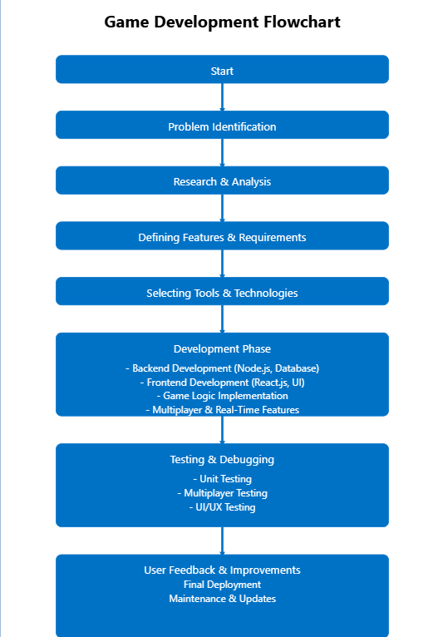
Methodology Flowchart
Notes:
New Courses replaced with New Programmes

Slide 15
Project Timeline
Phase 1: Project Planning & Requirements
Duration: 1 week
Tasks: - Finalize the game concept and rules (e.g., number of cards, scoring system) - Identify essential features (e.g., difficulty levels, timer, leaderboard).
Phase 2: Research & Game Design
Duration 1 week
Tasks: - Analyze existing games for inspiration - Create wireframes and design the game interface - Finalize the user experience flow (e.g., how players will interact with the game).
Notes:
New Courses replaced with New Programmes

Slide 16
Project Timeline
Phase 4: Development (Core Features)
Duration: 3 weeks
Tasks: - Implement game logic (card flipping, matching, shuffling) - Develop difficulty levels (easy, medium, hard) - Add a timer and scoring system - Create a restart and shuffle feature
Phase 5: Advanced Features (Enhancements)
Duration: 2 weeks Activities: advanced features such as animations, sound effects, multiplayers feature and a leaderboard.
Tasks: - Implement card flip animations - Add sound effects (e.g., card flip, match, game over) - Create a leaderboard for top scores - Add a reset/restart buttons.
Notes:
New Courses replaced with New Programmes

Slide 17
Project Timeline
Phase 6: Deployment & Launch
Duration: 1 week
Tasks: - Deploy on a hosting platform (e.g., GitHub Pages, Netlify) - Conduct final testing in the production environment - Launch the game and share the link with others.
Notes:
New Courses replaced with New Programmes

Slide 18
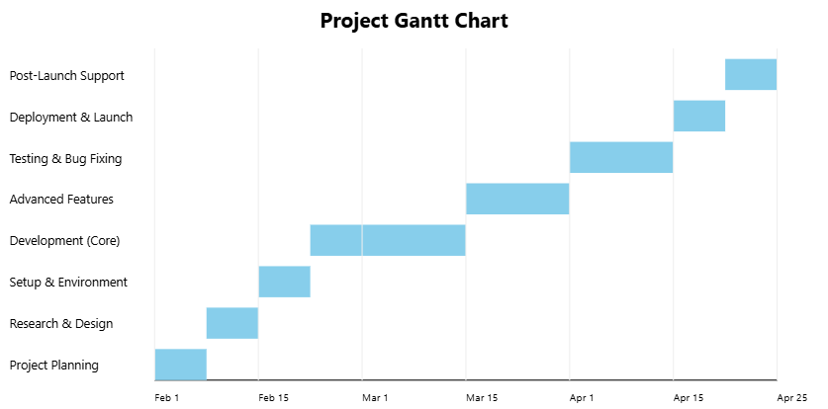
Project Timeline
Ghantt Table:
Notes:
New Courses replaced with New Programmes

Slide 19
Expected Results & Impact
Expected Results:
The goal of this project is to create a fully functional, engaging, and user-friendly memory game designed to enhance players' memory and cognitive abilities. The game will include various difficulty levels, a timer, a scoring system, and a responsive design to ensure compatibility across different devices. The final product will feature a working prototype that allows users to engage with the game, providing an enjoyable and challenging experience while fulfilling its educational objectives.
Notes:
New Courses replaced with New Programmes

Slide 20
Expected Results & Impact
Impact:
This project aims to make a significant contribution to the educational gaming sector by offering a tool that improves memory and concentration through interactive play. It will also demonstrate the application of React in developing interactive web games, serving as a valuable resource for researchers focused on cognitive enhancement. Users will find an entertaining way to sharpen their memory skills, and potential future developments, such as multiplayer options or advanced analytics, could further enhance its functionality and reach.
Notes:
New Courses replaced with New Programmes

Slide 21
References
Memory Matching Game (2025). Memory Game. Retrieved From https://www.memorymatching.com/
Memory Game - Brainzilla. Retreived From : https://www.brainzilla.com/fun/memory-game/
Carter, B. & Evans, J. (2022). “User Experience in Memory Game Design: Balancing Challenging and fun, Game Development Review.
Lee, R. (2020). “Enhancing Memory Retention through Game Mechanics.” Psychology and Games, 14(1)), 77-90.
Notes:
New Courses replaced with New Programmes

Slide 22
THANK YOU

